Slide 1
Central Jamaica Conference
Child Preachers Training
Sermon Preparation

Slide 2
What is a Sermon ?

Slide 3
What is a Sermon
A sermon is a speech delivered from the Bible to teach people about faith, morals, and how to live a good life.

Slide 4
Why is Sermon Preparation Important

Slide 5
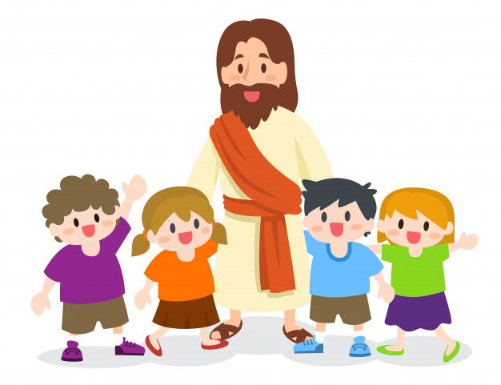
Why is Sermon Preparation Important
Sermon preparation is important because it helps make the message clear, interesting, and easy to understand, guiding them in their faith journey in a fun and engaging way.

Slide 6
Types of Sermons
Expository Sermons: These sermons explain and explore a specific passage or book of the Bible in detail, often verse by verse. Example: A sermon on Psalm 23, unpacking its meaning and relevance to daily life.
Topical Sermons: These sermons address specific topics or themes relevant to the audience, drawing from various passages of scripture to support the message. Example: A sermon on forgiveness, exploring biblical principles and examples of forgiveness.

Slide 7
Types of Sermons
Narrative Sermons: These sermons tell a story or narrative from the Bible, focusing on its characters, plot, and lessons to convey a moral or spiritual truth. Example: A sermon on the parable of the Good Samaritan, emphasizing the importance of showing compassion to others.
Biographical Sermons: These sermons examine the life and experiences of a biblical character or historical figure, drawing lessons and insights applicable to contemporary life. Example: A sermon on the life of David, highlighting his victories, failures, and faithfulness to God.

Slide 8
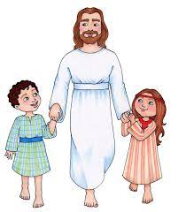
What are the parts of a Sermon

Slide 9
Parts of a Sermon
The structure of A sermon is like the physical structure of A dog: it has A head, A body and A tail. Similarly, a Sermon has a
Introduction
A body and
A conclusion/appeal.

Slide 10
How to prepare for your Sermon
Prepare Yourself: take time to pray and meditate, seeking God's guidance, wisdom, and inspiration.
Understand Your Audience: Familiarize yourself with the age group, interests, and attention span of the children you'll be speaking to. Adapt your language, content, and delivery style accordingly.
Choose a Relevant Topic/ Scripture: Select a topic that is age-appropriate, relatable, and relevant. Prepare to use stories, examples, and illustrations that resonate with their experiences and interests.
Do your research: review other books, find illustrations and stories
Simplify the Message: Break down complex concepts into simple, easy-to-understand nuggets.
Practice: Rehearse your sermon delivery to ensure clarity, timing, and effectiveness.

Slide 11
Activity
Choose Sermon Type
Choose topic/ Scripture
Choose Title

Slide 12
Quiz

